Slide 1
Bio-Inspired High Speed Pupil-Tracking using a Dynamic Vision Sensor
Joseph Warren, Aldo Faisal, Yufei Wu

Slide 2
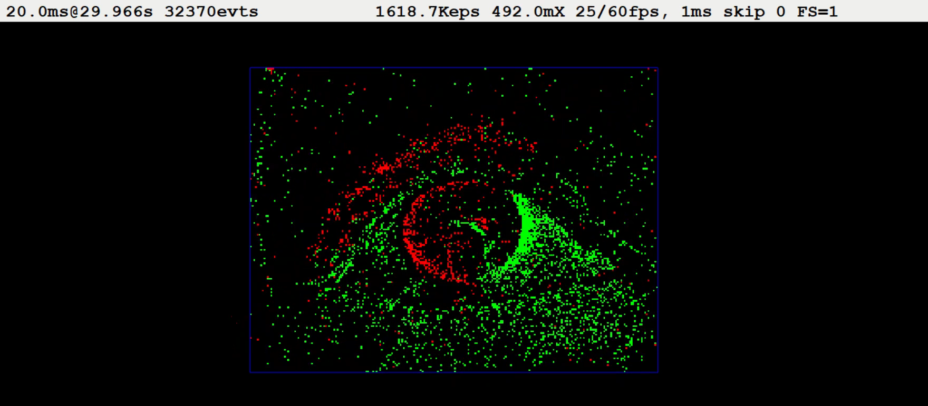
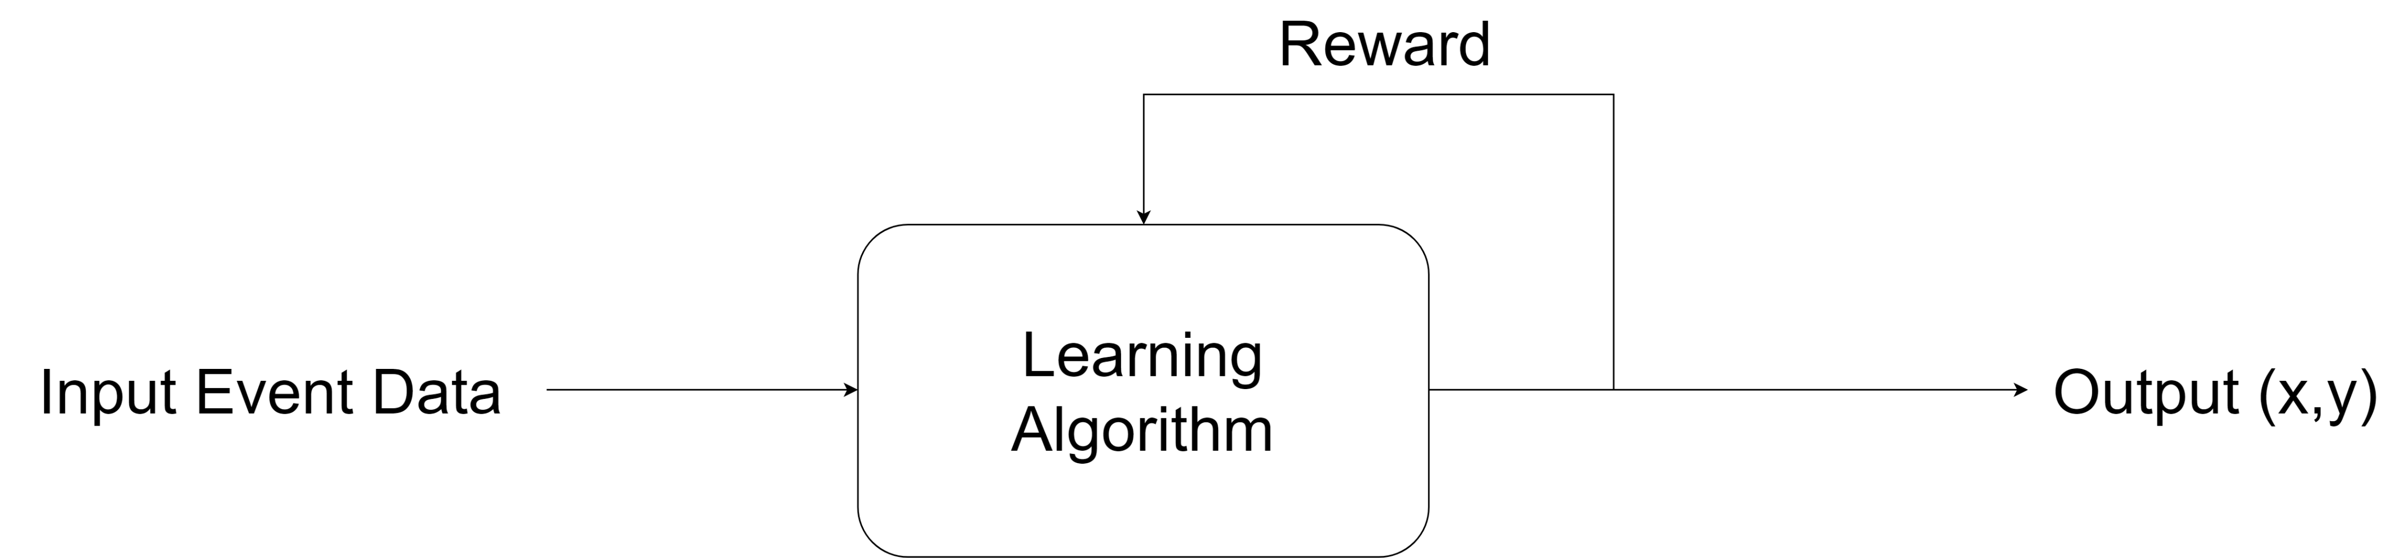
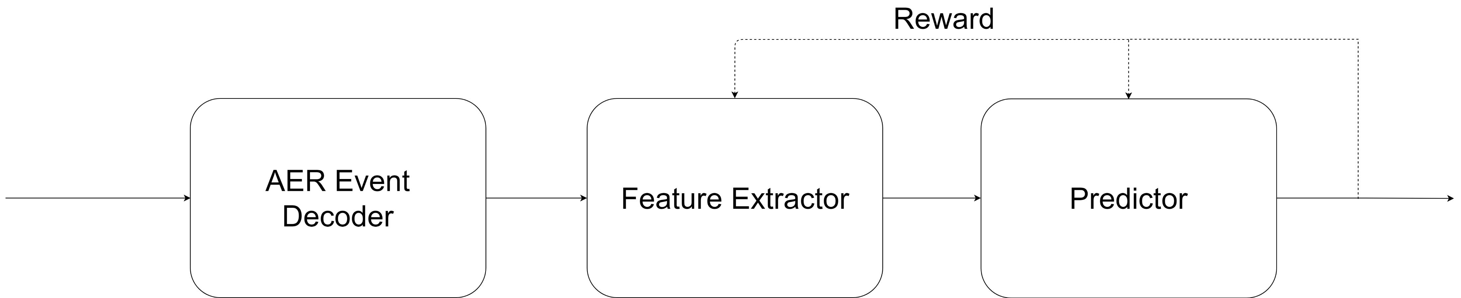
Algorithmic Framework
Pupil Position (x,y)

Slide 3
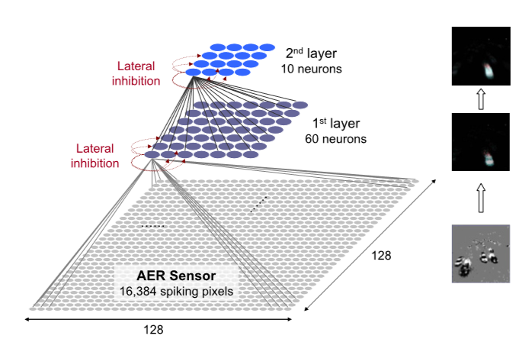
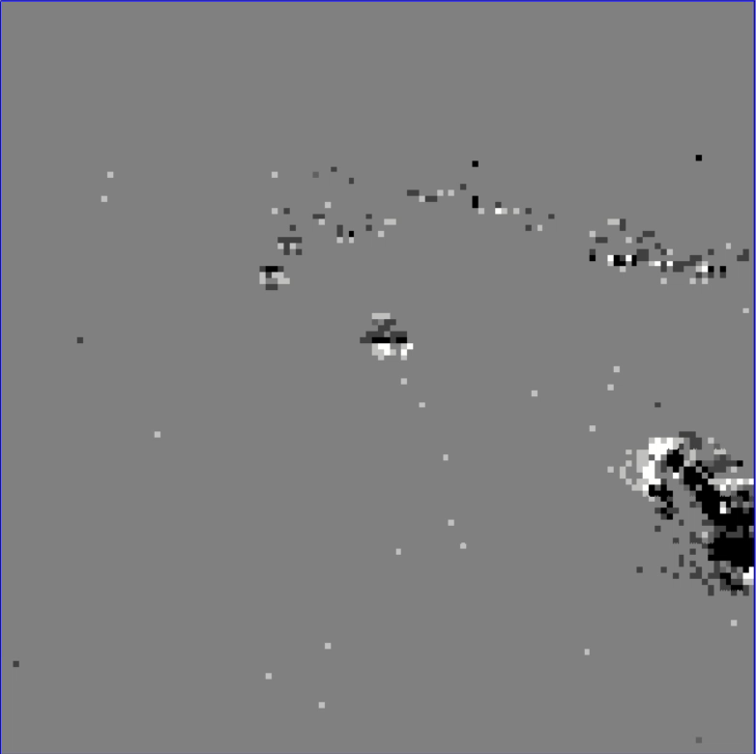
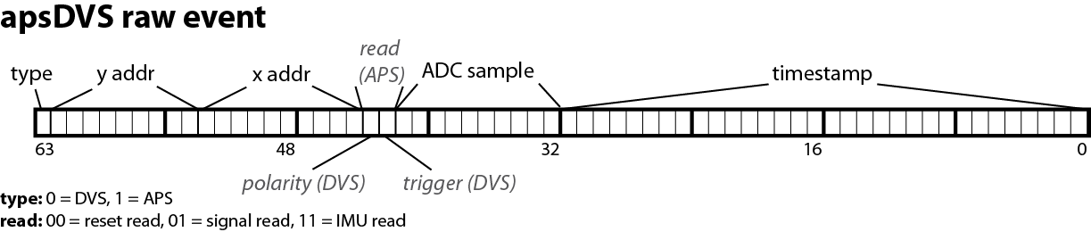
Case Study – Feature Extraction from highway footage
Bichler O, Querlioz D, Thorpe SJ, Bourgoin J and Gamrat C. Extraction of temporally correlated features from dynamic vision sensors with spike-timing-dependent plasticity. Neural Networks. 2012; 32 339-348.

Slide 4
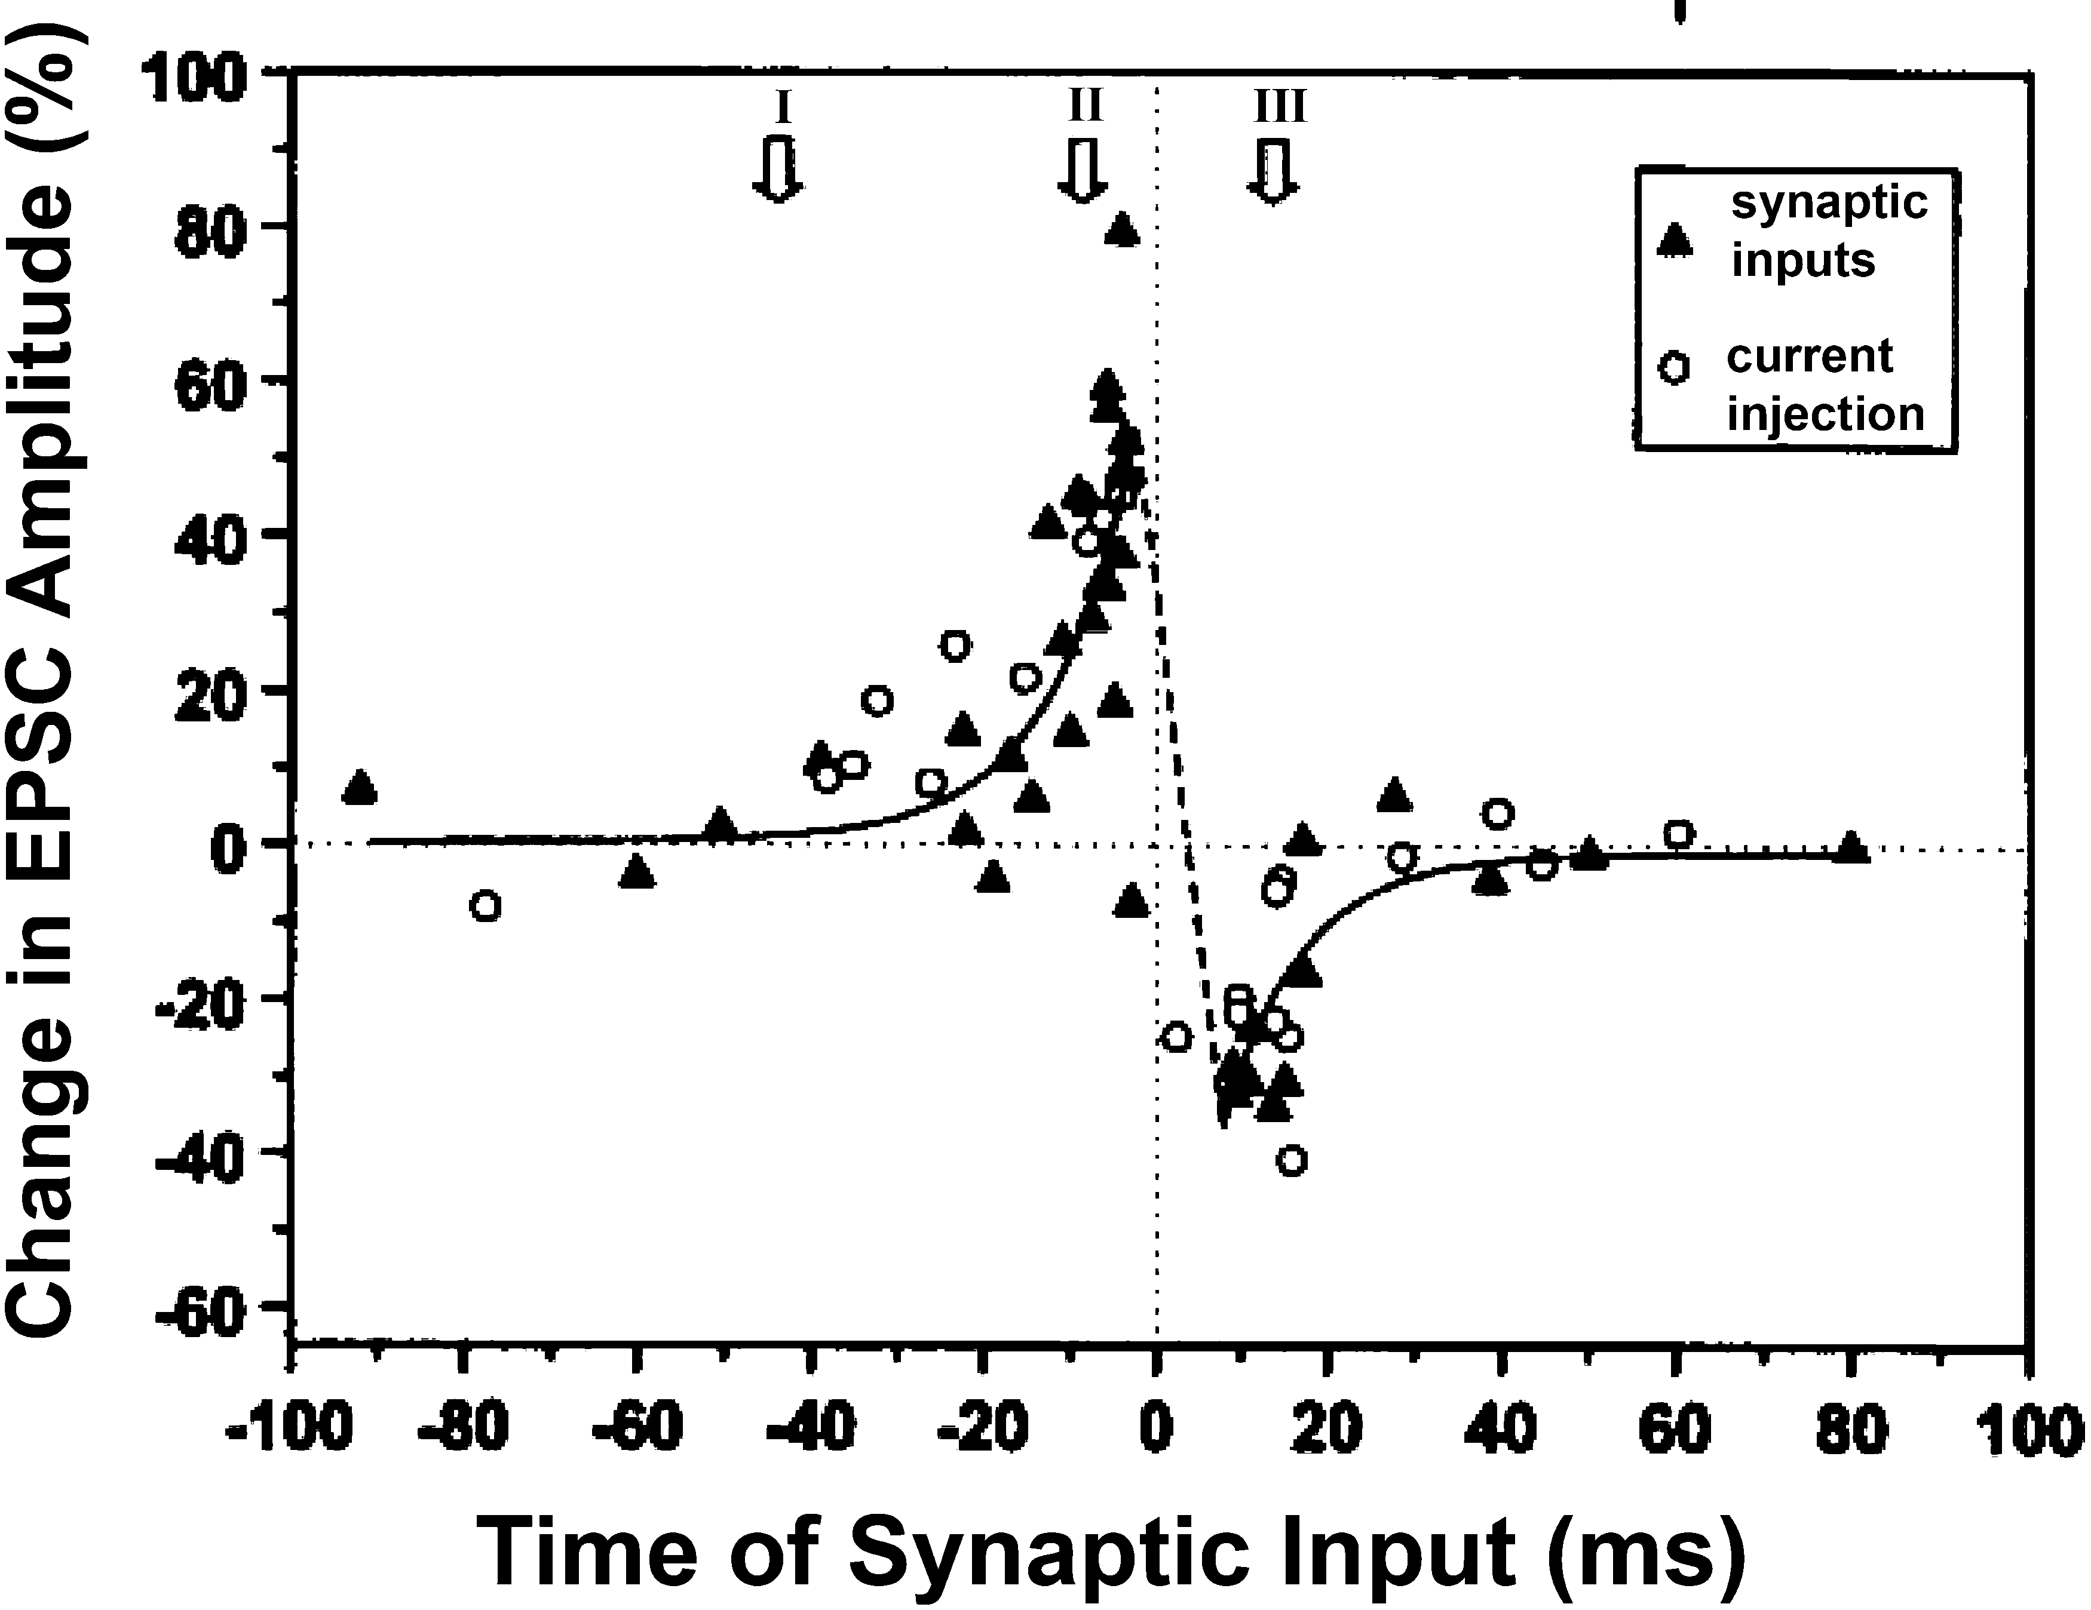
Learning Rules for Feature Extraction
STDP
Creates selectivity to spatio-temporal patterns
Lateral Inhibition
Leads to competition between neurons
Dan Y, Poo MM. Spike timing-dependent plasticity of neural circuits. Neuron. 2004; 30;44(1):23-30

Slide 5

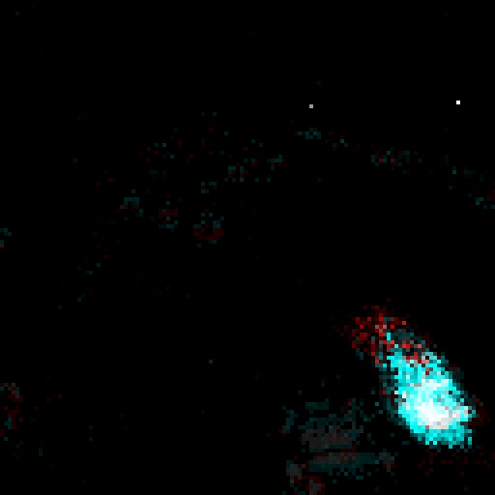

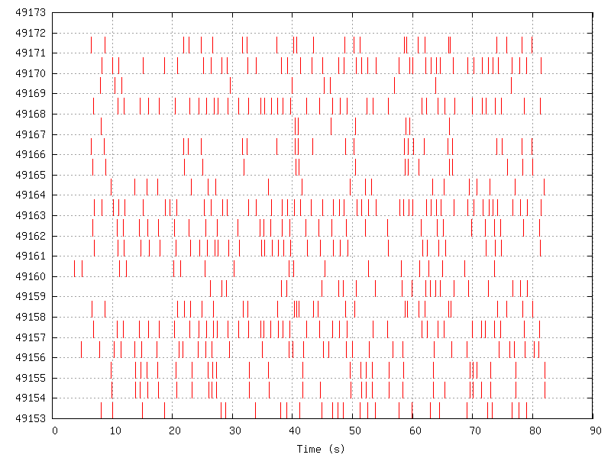

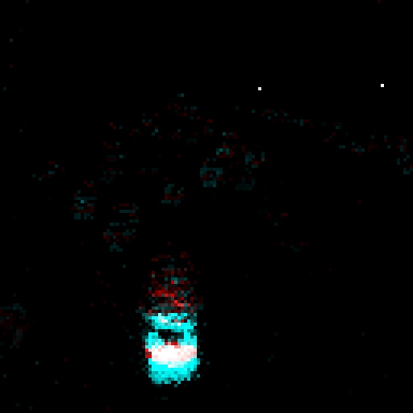





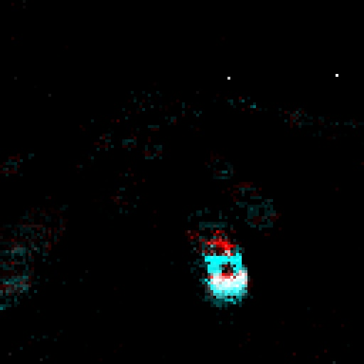
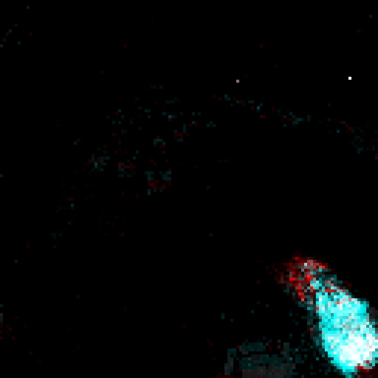
Reproduced results
Neuron ID
Reconstructed Receptive Fields

Slide 6
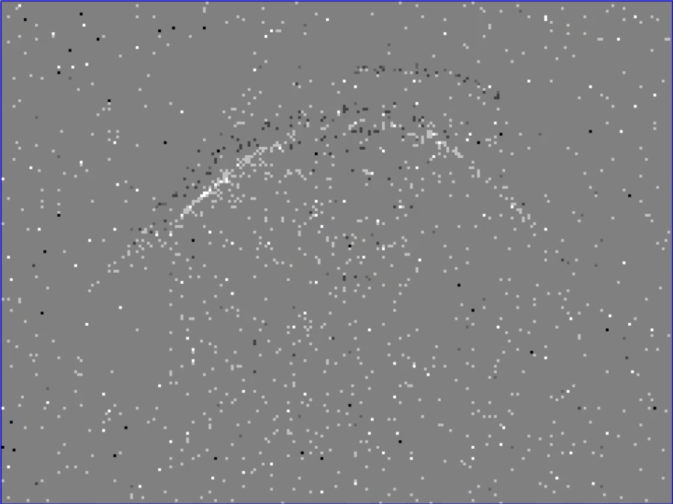
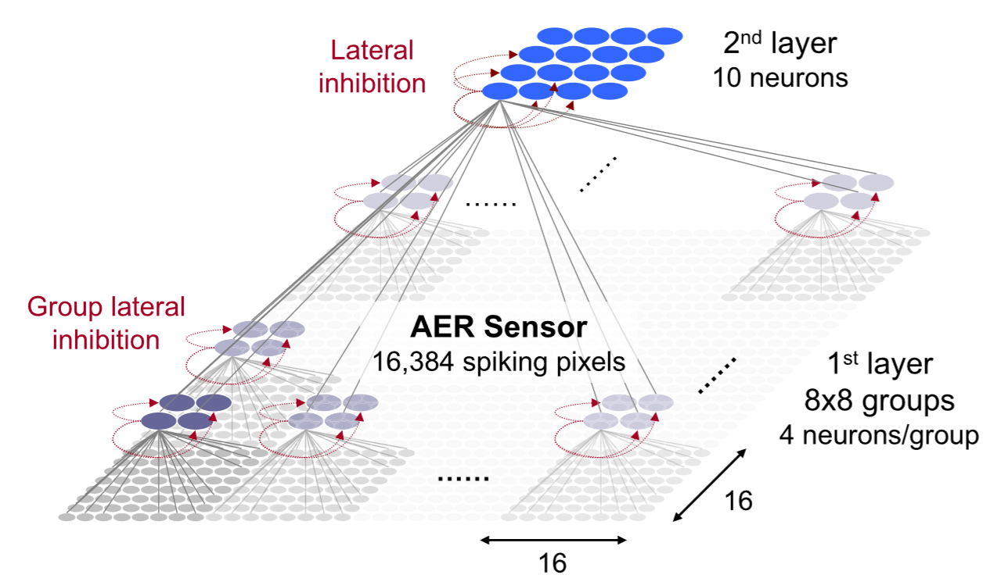
Network Architecture & Data
~40000
5x5 groups
10 neurons/group
5
5

Slide 7


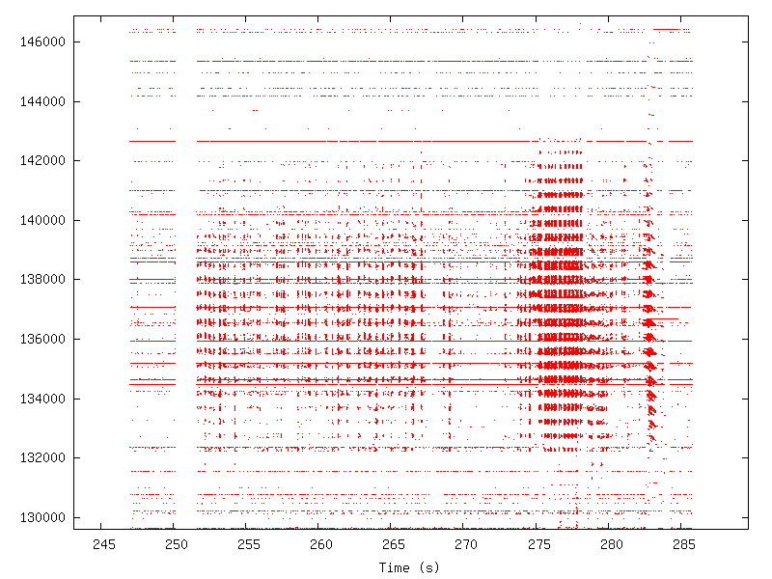








Results
Receptive Fields for 10 neurons covering 5x5 patch
Neuron ID

Slide 8
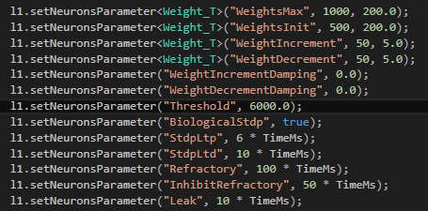
Problem: Parameter Tuning
Parameters affect neuron dynamics and selectivity to stimuli
Parameters:
Threshold
STDP duration
Refractory period
Inhibitory refractory period
Leak time-constant
How to select these?

Slide 9
Solution
Parameters depend on timescale of features of interest
Leak ~ duration of feature
STDP ~ duration of feature
Threshold ~ expected events per feature * synaptic weight
Refractory Period ~ expected repetition frequency of feature
Inhibitory Refractory Period ~ time between different features
3 Main eye movements
Saccades
Smooth Pursuit
Blinks
3 Different Timescales
3 neuronal populations

Slide 10
Example: Parameters for Saccade
~ 900 deg/s
Assume eye motion restricted to 120 deg
Assume range of eye motion perfectly fits pixel array
130ms to for pupil to traverse screen
Screen = 200 pixels across
Pupil moves 1.5 pixel/ms during saccade
Receptive Field (RF) = 5 pixels across
~3ms to traverse RF
Need to select for features on timescale of ~ms !

Slide 11
Problem: Processing Speed
Simulator has event queue
Event queue = list of events (spikes) to route to neurons
More synapses = duplication of events
Length of event queue (appears to be) limiting factor
General run-time
Periods of high event input
Metrics for characterising processing speed:
Synaptic events/s
Slow down factor
Lag

Slide 12
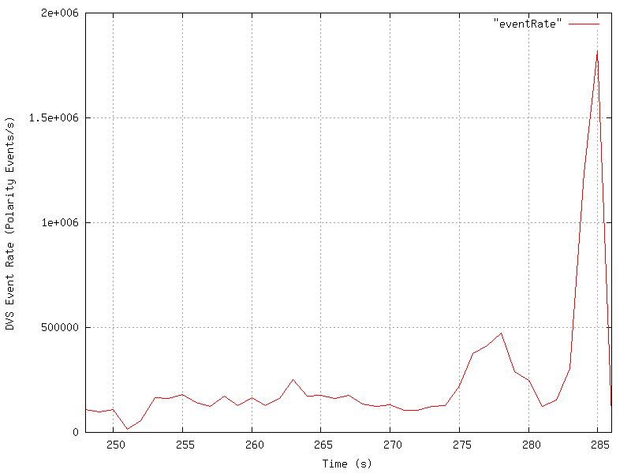
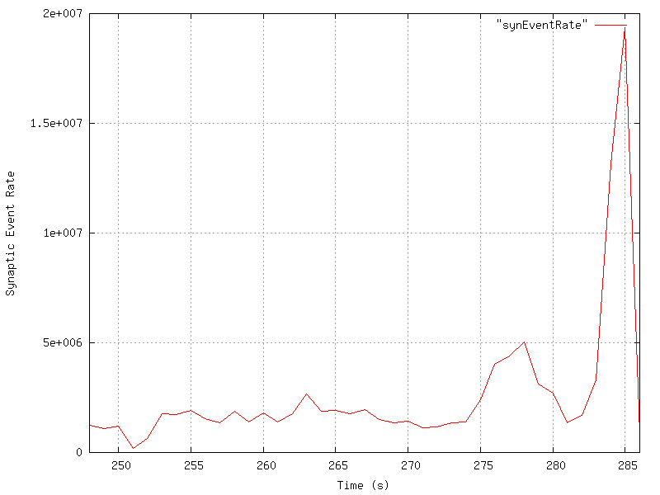
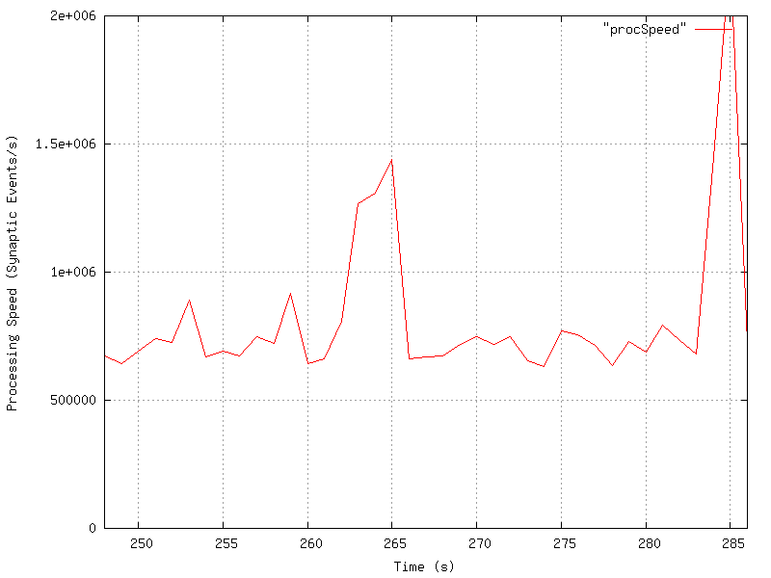
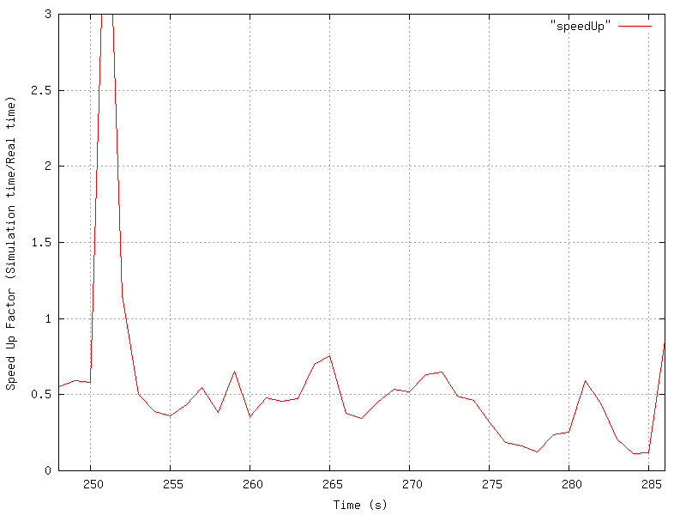

Slide 13
Solutions
Synaptic Death
Remove synapses below threshold weight
Reduces event duplication
Rate capping/neuron deactivation
Neuron with very small time constant (~100 us) and low threshold
Detects high event rates
Deactivates other neurons for short period of time
No further events routed to deactivated neurons

Slide 14
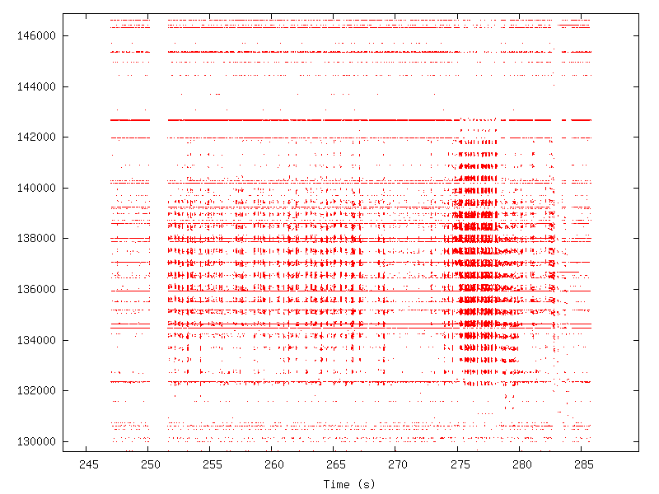
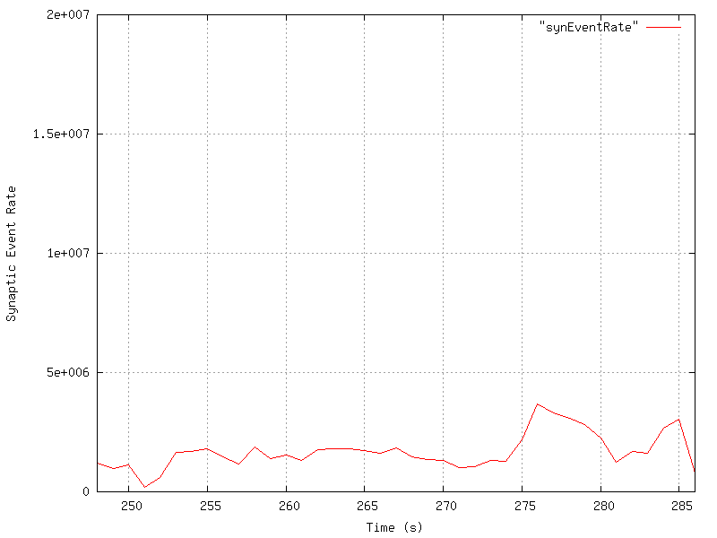
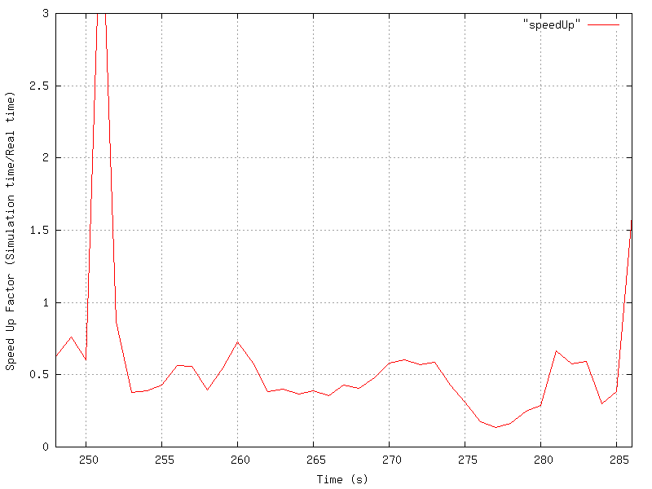
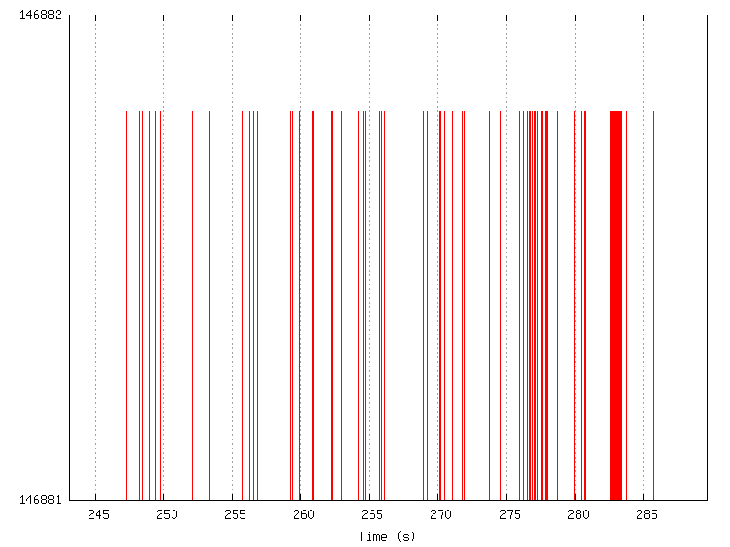
Rate Capping

Slide 15
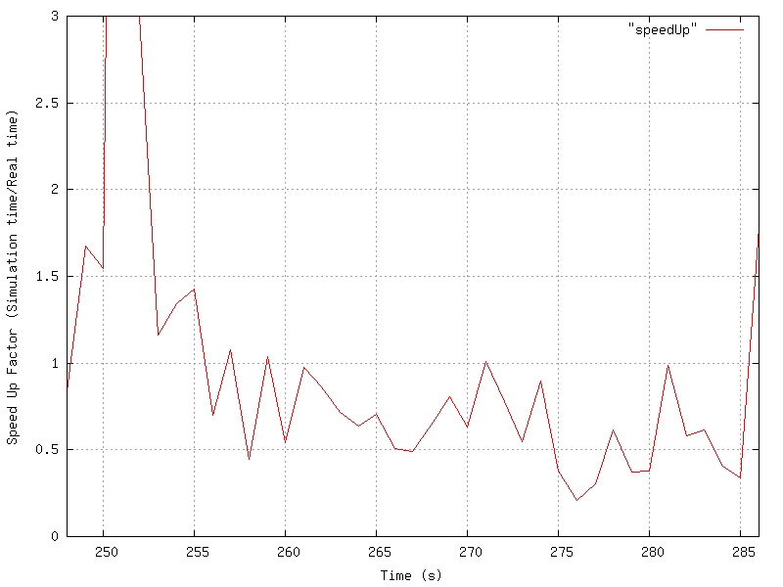
Synaptic Death
Before Synaptic Death & Capping
After Synaptic Death & Capping

Slide 16
To do list
Test performance on lab computer
Need >1 Speed Up factor!
Weight sharing during learning
Accumulate a training dataset
With IR light!
Method to save network state (synaptic weights)
Integrate simulator with live data streams

